Slide 1
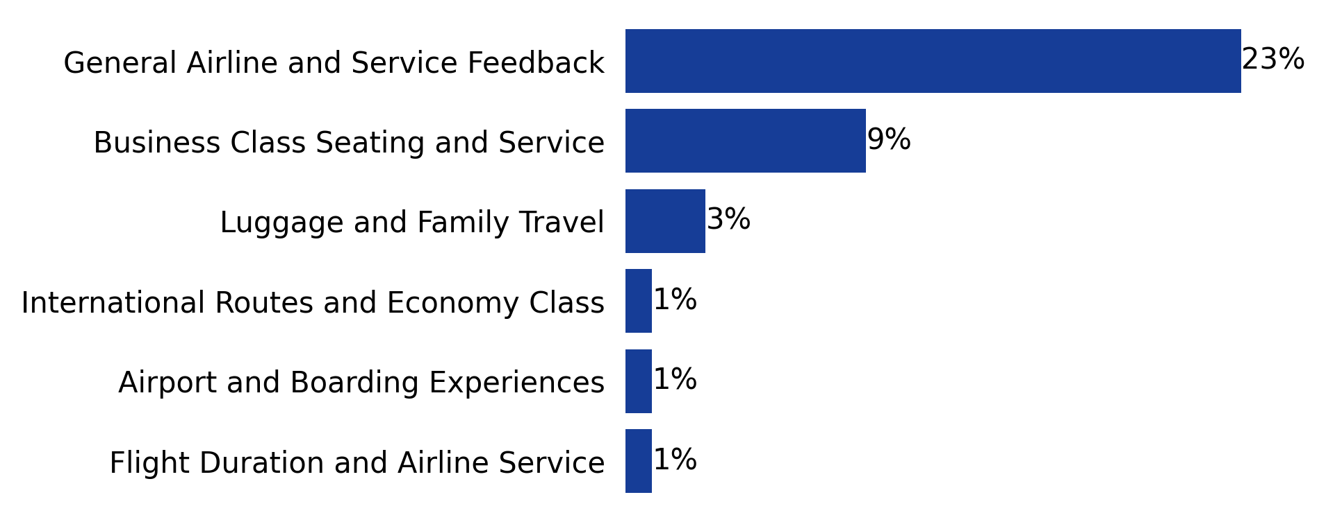
While overall passenger sentiment is positive, significant opportunities for improvement remain evident across various experiences.
How does passenger sentiment vary across different service areas?
(AVERAGE SENTIMENT SCORES ACROSS SERVICES)

